Slide 1
AI Research Companion
Your Interactive Research Buddy
Major project –COE(AI/DS)

Slide 2
Problem: The Challenge of Modern Research
Researchers and students face information overload from dense academic papers and technical documents.
Manually finding specific information across multiple sources is slow and inefficient.
Synthesizing knowledge and discovering connections between documents is a significant manual effort.

Slide 3
Solution: A Smarter Way to Research
Core Idea: Transforming static documents into a dynamic, conversational knowledge base.
"Instead of reading through documents, you can now talk to them."

Slide 4
Key Features
Multi-PDF Upload: Analyze up to 3 documents simultaneously for a unified context.
Interactive Q&A: Ask questions in natural language and get precise, context-aware answers.
AI-Powered Suggestions: Receive intelligent follow-up questions to guide your inquiry and spark new ideas.
Modern & Secure: A clean, dark-mode interface with secure, session-based processing.

Slide 5
Under the Hood: Retrieval-Augmented Generation (RAG)
PDF Upload ➡️ Chunking ➡️ Embedding (Vector Store) ➡️ User Question ➡️ Similarity Search ➡️ LLM Generation ➡️ Final Answer
Simplified Steps:
Ingest & Index: The app breaks down your PDFs into small pieces and creates a searchable "map" of the content.
Retrieve: When you ask a question, it finds the most relevant pieces from the map.
Generate: It gives those relevant pieces and your question to the Gemini AI, which formulates a final, accurate answer.

Slide 6
Technology Stack
Backend | Frontend
Python & Flask | HTML, CSS
LangChain | JavaScript
Google Generative AI (Gemini) | Bootstrap 5
FAISS Vector Store

Slide 7
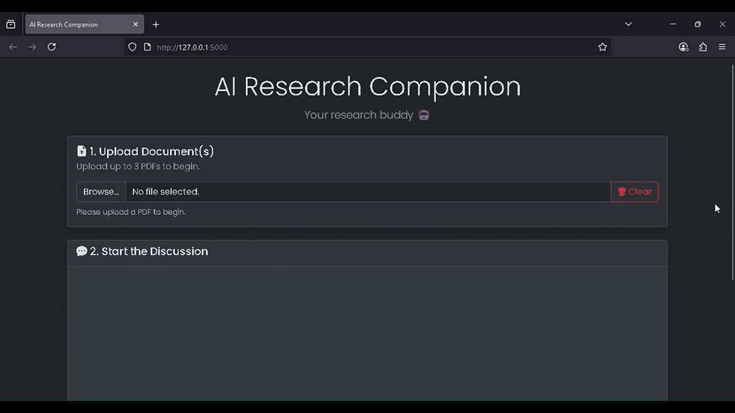
Demo

Slide 8
Future Work
Support for More File Types: Add functionality for .docx, .txt, and even website URLs.
Chat History Persistence: Allow users to save and return to their research sessions.
Source Highlighting: Show the user exactly which part of the document was used to generate an answer.
User Accounts: Implement user authentication for private document storage.

Slide 9
THANK YOU!!!
Srinidhi Poreddy(22B81A67B4)
Snehanjali Kamatam(22B81A67B2)

